Slide 1
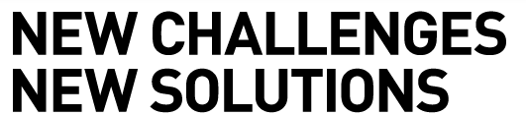

Batch Customization
10/20/2014
Presenters name, Title - Date

Slide 2
Batch Architecture
10/20/2014

Slide 3
Facets Virtual Server
System Metrics as of Facets 4.61
Facets Interactive
9,455,833 lines of C++ code
446 Applications
Facets Database
1,500+ Database Tables
17,000+ Stored Procedures
Facets Application Server
206 Batch Jobs
Facets Services
388 Services

Slide 4
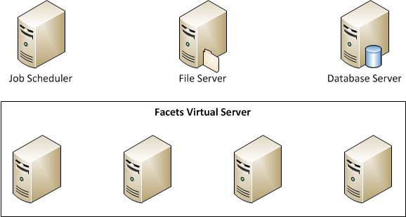
Facets Virtual Server
Overview
Supports all back office Facets functionality.
Batch, Services, and Interactive
Fits into the enterprise solution architecture.

Slide 5
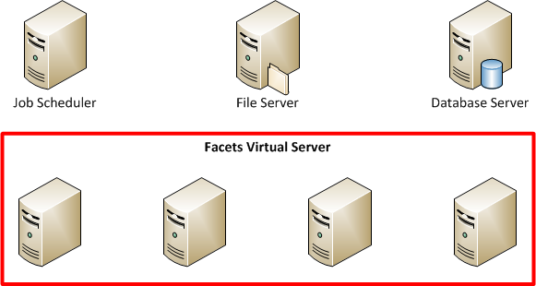
Facets Virtual Server
Isolation
Provides a logical boundary separating Facets from the rest of the enterprise.
Abstracts users of the Facets Virtual Server from the physical nature of the configuration.
Simplifies the connectivity to Facets.

Slide 6
Facets Virtual Server
Redundancy
No single point of failure.
Configuration supports redundancy constructs at all levels:
Application Server, File Server, Database

Slide 7
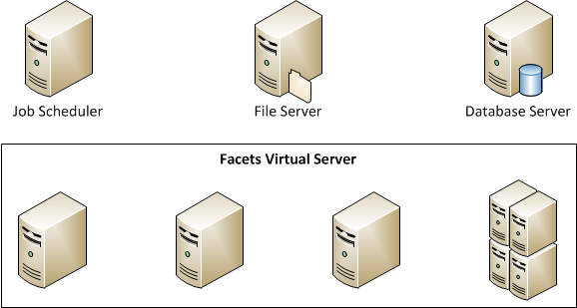
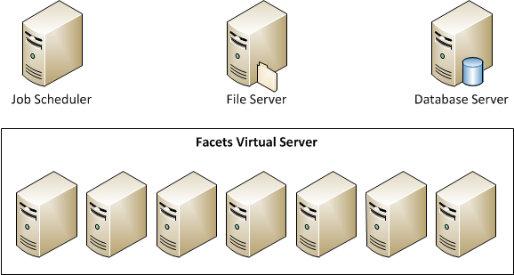
Facets Virtual Server
Scalability
Scale Application Servers.
Out by adding more servers
Up by adding CPUs to a server

Slide 8
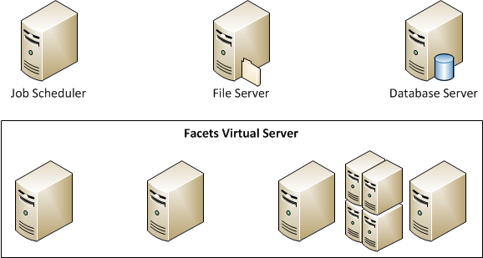
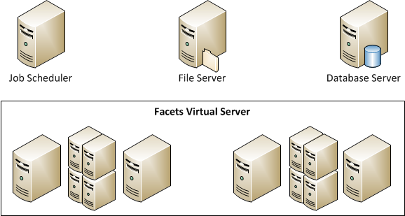
Facets Virtual Server
Flexibility
Supports “n” number of configurations.
“n” number of machines
“n” processors per machine

Slide 9
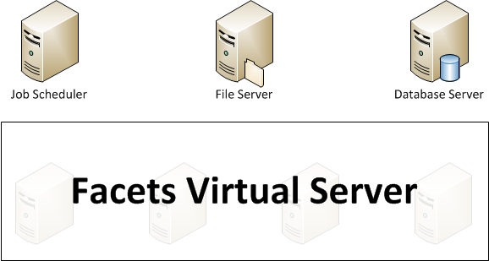
Facets Virtual Server
Manageability
Provides one logical view of the physical environment.
The user and operator are abstracted from the physical nature of the system.
Perceive managing one virtual environment.
Single system image.

Slide 10
Region
10/20/2014

Slide 11
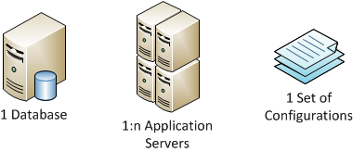
Region
Definition
All of the necessary components required to run Facets.
Stored in a Region Store, which is physically ErSystCfgSystem###.xml.
There is one centralized Region Store per Region.
Components

Slide 12
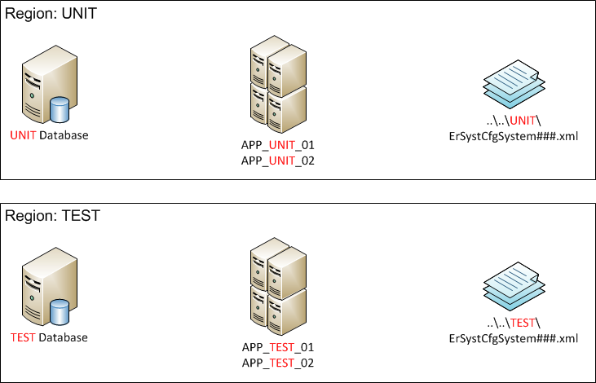
Region
Region Directory
Houses 1:n Region Stores of available regions.
Physically a centralized location accessible to all application servers.

Slide 13

Region
Region Directory
Region Stores can share resources.

Slide 14
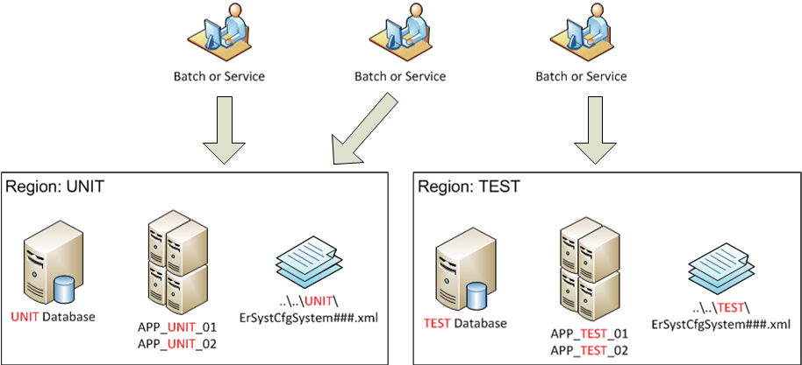
Region
Run-Time
At run time, Facets executes against one specific region.

Slide 15
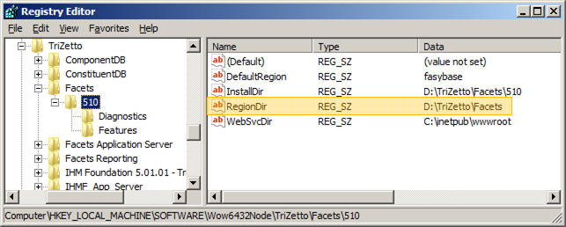
Region
Region Directory
The location of the Region Directory is defined by a registry entry on each application server.
HKEY_LOCAL_MACHINE\SOFTWARE\Wow6432Node\TriZetto\Facets\510\

Slide 16
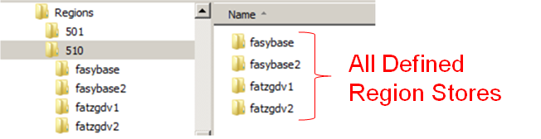
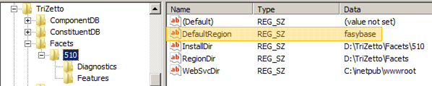
Region
Default Region
The default region is defined by a registry entry on each application server.
Determines the region that the system will use in the absence of any override.

Slide 17
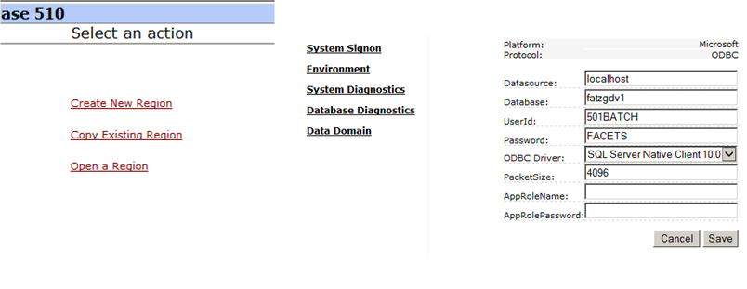
Region
Region Manager
Abstracts users from the physical region configuration file.
Allows users to edit existing regions.
New regions can be crated from scratch or by copying existing regions.

Slide 18
Region
Installation
Choose to create a new region or join an existing region.
Ensures consistent configuration in a distributed environment.
Creating a Region
At installation time, all criteria needed to define a region is gathered.
Joining a Region
At installation time, all that is needed is the name of the region that will be joined.
The application server being installed is simply added to the specified region.

Slide 19
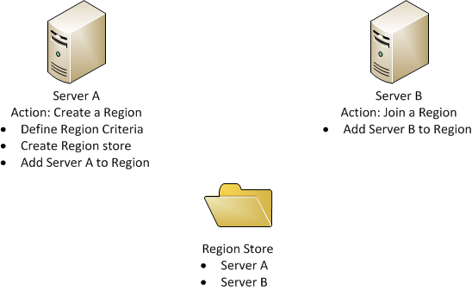
Region
Installation
Installing multiple servers is easy and guaranteed to be consistent.

Slide 20
Facets Batch
10/20/2014

Slide 21
Batch
Overview
Facets batch processes are designed to process transactions in the absence of user interaction.
Execute within the Facets Virtual Server, typically initiated via scheduling software.
Take advantage of the distributed computing architecture while at the same time presenting a consolidated logical view of the system.
Leverage processing techniques as well as environmental components to scale processing to the levels required by the customer.
Support all the fundamentals of the Facets Virtual Server.

Slide 22
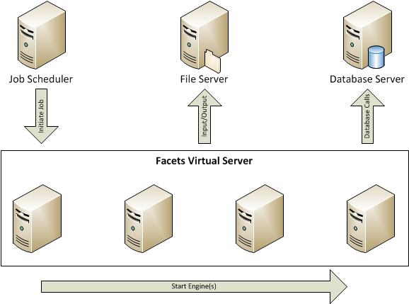
Batch
Execution
The batch is initiated via an external job scheduler on the designated job manager machine.
The batch executes on 1:n servers within the environment.

Slide 23
Batch
Definition
Batch Jobs are defined by a combination of four components.
Region File
Procedure File
Runbook
Command Line
Components
Region File: Configuration parameters defined at region level
Procedure File: Job definition
Runbook: Job specific parameters
Command Line: Job specific parameters

Slide 24
Batch
Procedure File
Defines the batch job in terms of what executes and the order in which it executes.
Decomposed into three levels
Job Comprised of one or more steps. Overrides at this level apply to every step and action unless subsequently overridden.
Step Comprised of one or more actions. Overrides at this level apply to every action within the step unless subsequently overridden. Control (Bypass, Restart, Stop) is at this level
Action Work is done at this level. Overrides at this level apply only to this level. Types include Executable, SQL, Command or Script.

Slide 25
Batch
Runbook
Provides a means for parameters to be set at any level.
Points to a procedure file.
1:n runbooks can point to a given procedure book.
Command Line
Provides a means for parameters to be set at any level.
Region File
Provides a default values for parameters for a region.

Slide 26
Batch
Parameter Hierarchy
Region File
Procedure File
Runbook
Command Line
Region File
Procedure File
Runbook
Command Line

Slide 27
Batch
Job Control
Always at the Step Level
Restart: Begins processing at the specified step.
Bypass: Bypasses the processing for the specified step(s).
Stop: Stops processing prior to executing the specified step.
Example: Restart, Bypass, and Stop at Step 2000
Restart
Bypass
Stop
Step 1000
Step 1000
Step 1000
Step 2000
Step 2000
Step 2000
Step 3000
Step 3000
Step 3000

Slide 28




Batch
Command Line
Executes in a cscript.exe process.
Command line MUST supply a runbook.
Command line may optionally supply:
Region
Command line parameter overrides
Job Directives (Bypass, Stop, Restart)
Windows Script Host
Windows Scripting File
Runbook
Non-Default Region

Slide 29
Batch
Type of Action
Executable
C++ objects used for most intensive processing steps
Executes within a CerComHost###.exe process.
Distributed to any application server within the Facets Virtual Server.
1:n CerComHost###.exe comprise a multi-engine action.
SQL
Server side logic, typically used for moving large amounts of data.
Executes within a CerComHost###.exe process although processing is done on the database server.

Slide 30
Batch
Type of Action
Script
Windows Scripting Language (VBScript) code that executes in its own process.
Typically used for lightweight logic to support the process flow of a job.
Command
DOS style commands.
Typically used for file handling and manipulation

Slide 31
Q & A
October 16, 2014

